Slide 1
Tensor Decomposition

Slide 2
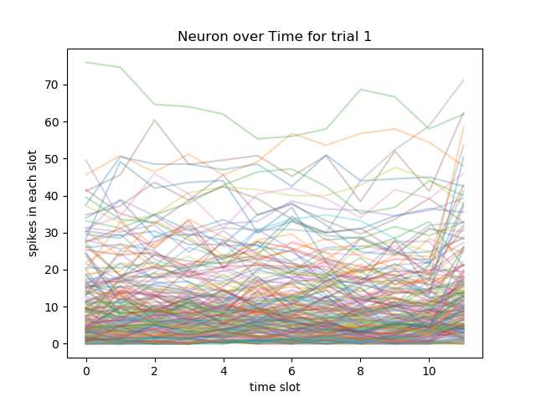
Data
>>> data.shape
(195, 8, 12)
195 neurons.
8 trials.
12 time slots.
>>> np.max(data)
116.0
>>> np.min(data)
0.0

Slide 3
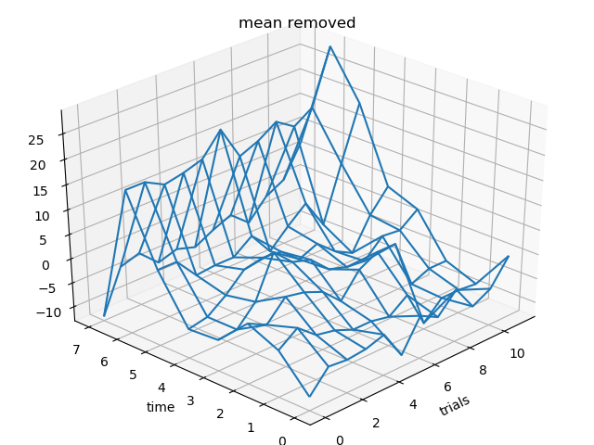
Normalization
Remove average value for each neuron across all trials and time slots.

Slide 4
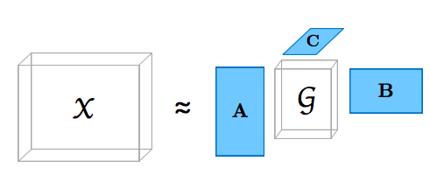
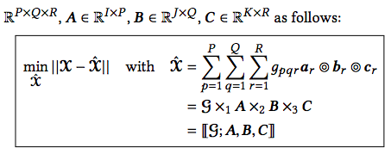
Tuck Decomposition

Slide 5
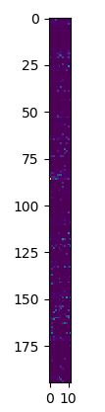
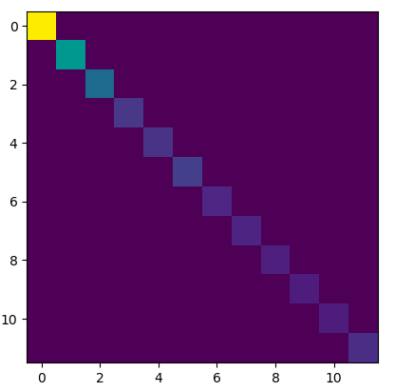
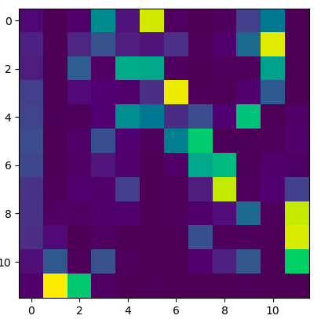
Tuck decomposition on one slice =?= PCA
>>> single = data[:,0,:]
>>> core, factors = tucker(single, [195, 12])
>>> core.shape
(195, 12)
>>> factors[0].shape
(195, 195)
>>> factors[1].shape
(12, 12)

Slide 6
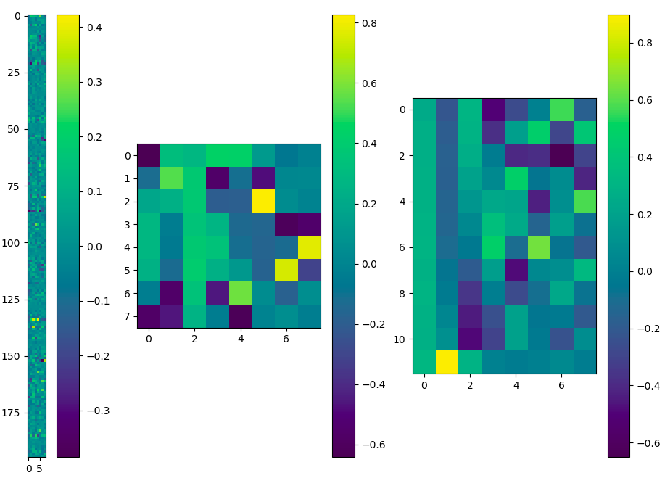
Tuck decomposition on 3D data
>>> data.shape
(195, 8, 12)
core, factors = tucker(data, [8,8,8])
>>> core.shape
(8, 8, 8)
>>> factors[0].shape
(195, 8)
>>> factors[1].shape
(8, 8)
>>> factors[2].shape
(12, 8)

Slide 7
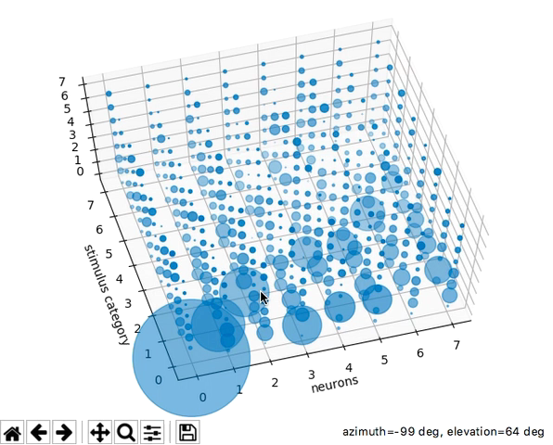
Tuck decomposition on 3D data

Slide 8
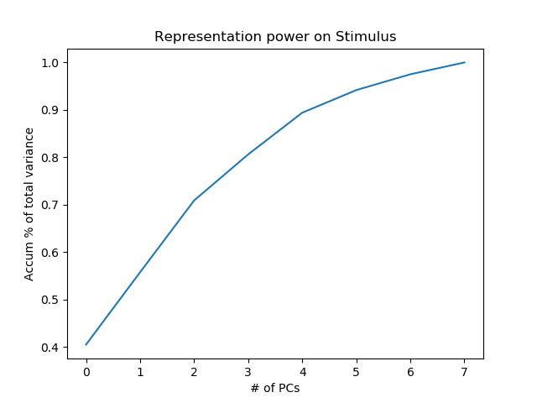
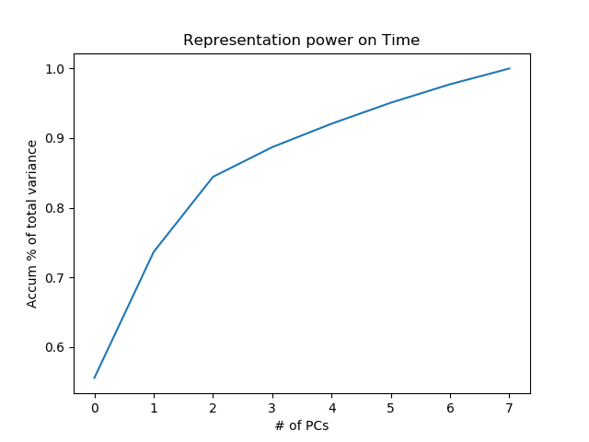
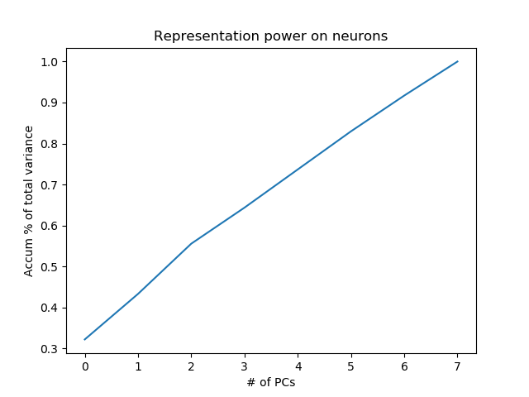
Expression power along PCs

